Slide 1
Skolkovo Summit of
Innovation Economy Creators
April 19, 2012

Slide 2
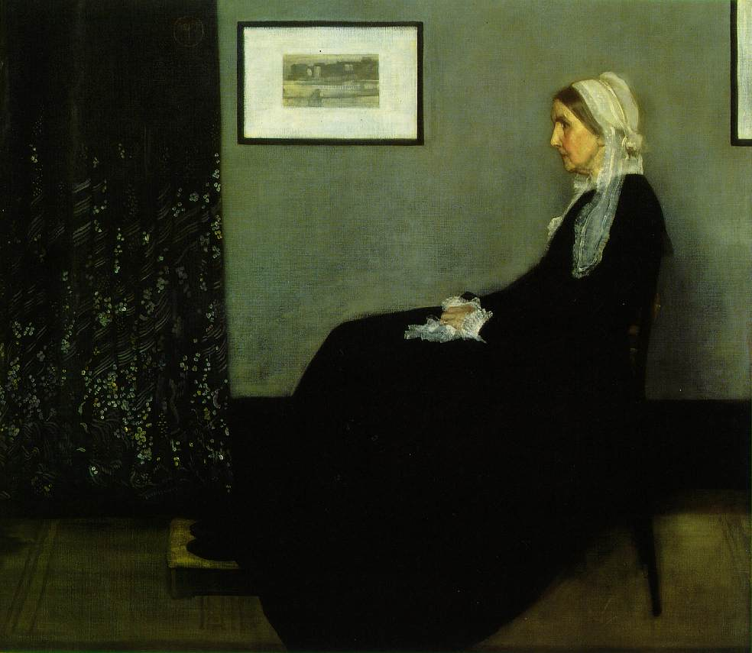
1) Innovation has evolved

Slide 3
Reverse innovation
Open source innovation
Large scale innovation
User centered design
Design thinking
Digital innovation
Indigenous innovation
Sustainability innovation
“Do more with less”
“Winning the future”

Slide 4
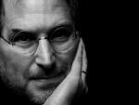
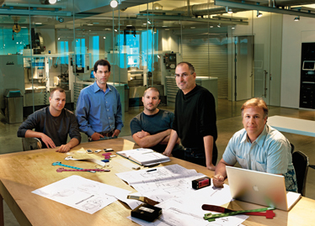
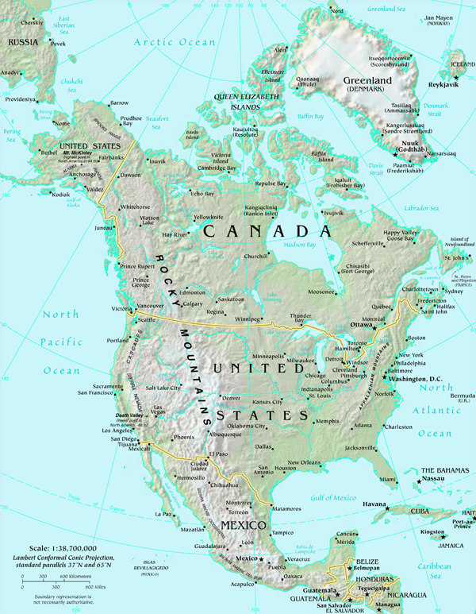
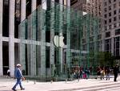
Notes:
Complexity of innovation
Psychological
Interpersonal
Organizational
societal

Slide 5
Three Eras of Innovation
Industrial Innovation - mass production, economies of scale, learning curve effects, improvement
High Tech Innovation - “startup nation,”
r & d, venture capital, culture of entrepreneurship, disruptive technologies, engineering prowess
Innovating Innovation - design thinking, social innovation, government 2.0, wicked problems,
cultural intelligence, mashups and arbitrage, social collaboration, STEAM

Slide 6
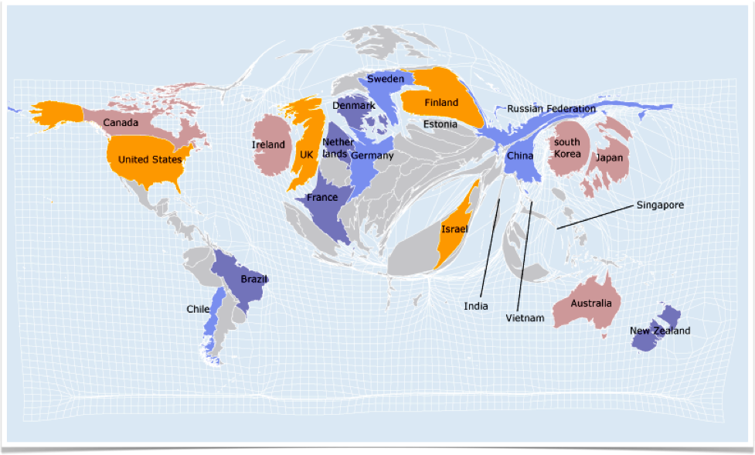
2) Innovation has globalized

Slide 7
A New Definition of Wealth
Traditional definition– Stuff. Money in the bank, oil in the ground, assets with an economic life. Nouns.
New definition - The sum of innovation ability, foresight, agility, risk appetite, and ability to experiment that continuously transforms what is possible into what is valuable. Verbs.
Notes:
When Denmark talks about being one of the 10 most wealthy countries, this is something to consider

Slide 8
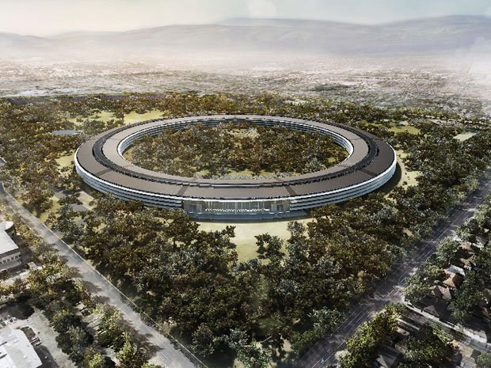
3) Scale matters, sort of

Slide 9

4) Risk-taking and failure are fundamental to innovation

Slide 10
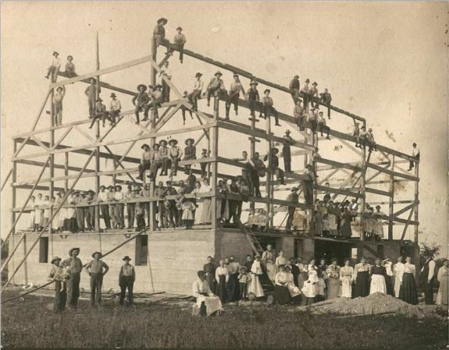
5) Trust and community are the glue
of an innovation ecosystem

Slide 11

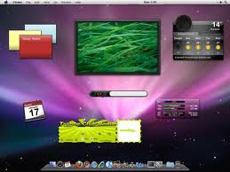
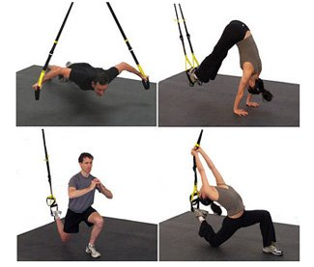
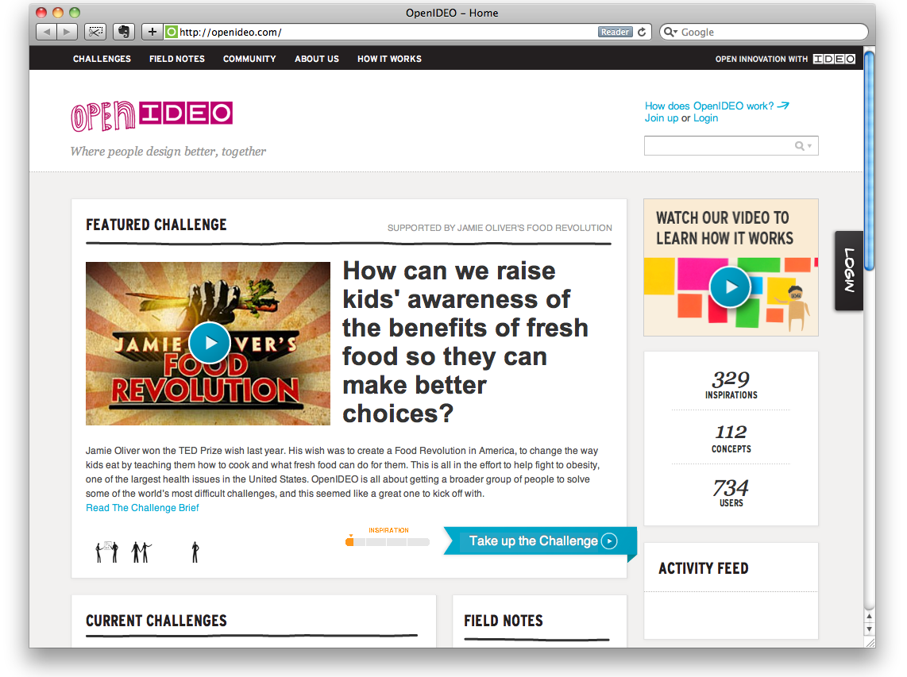

6) Infrastructure is turning “inside-out”

Slide 12

7) Innovation depends on freedom from preconceptions

