Slide 1
MONTHLY REPORT ON THE ACTIVITIES OF THE SKOLKOVO FOUNDATION
FEBRUARY 2013

Slide 2
Main Results of Skolkovo Foundation Activities
Success Stories
Increasing the quality of projects
Skolkovo participant Displair will present its innovative product at CeBit, the world's largest IT and telecom exhibition in Hanover;
PrimerLife announced the launch of a genetic social network;
The DО-RА project and Predicus (USA) signed a long-term contract on strategic partnership
News360 was recognized as the world's best startup at World Summit Award - Mobile Content
273
40 participating companies were inspected for compliance with the rules of the project in early 2013.
The inspection resulted in the loss of membership status by 3 companies.
ИТ
203
Биомед
230
Энерготех
68
Ядертех
83
In connection with the approach to the target value for number of participants (1000 participants) starting from the second quarter of 2013 a mechanism to limit accepting new participants through higher demands for project quality will be implemented
Космос
New Skolkovo Participants
In 2013 33 companies have received participant status; the total number of project participants is 857.
Project Financing
In 2013. The Skolkovo Foundation approved the issuance of grants to participants for a total amount of 311 million rubles; the total sum of approved grants was 9.3 billion rubles.

Slide 3
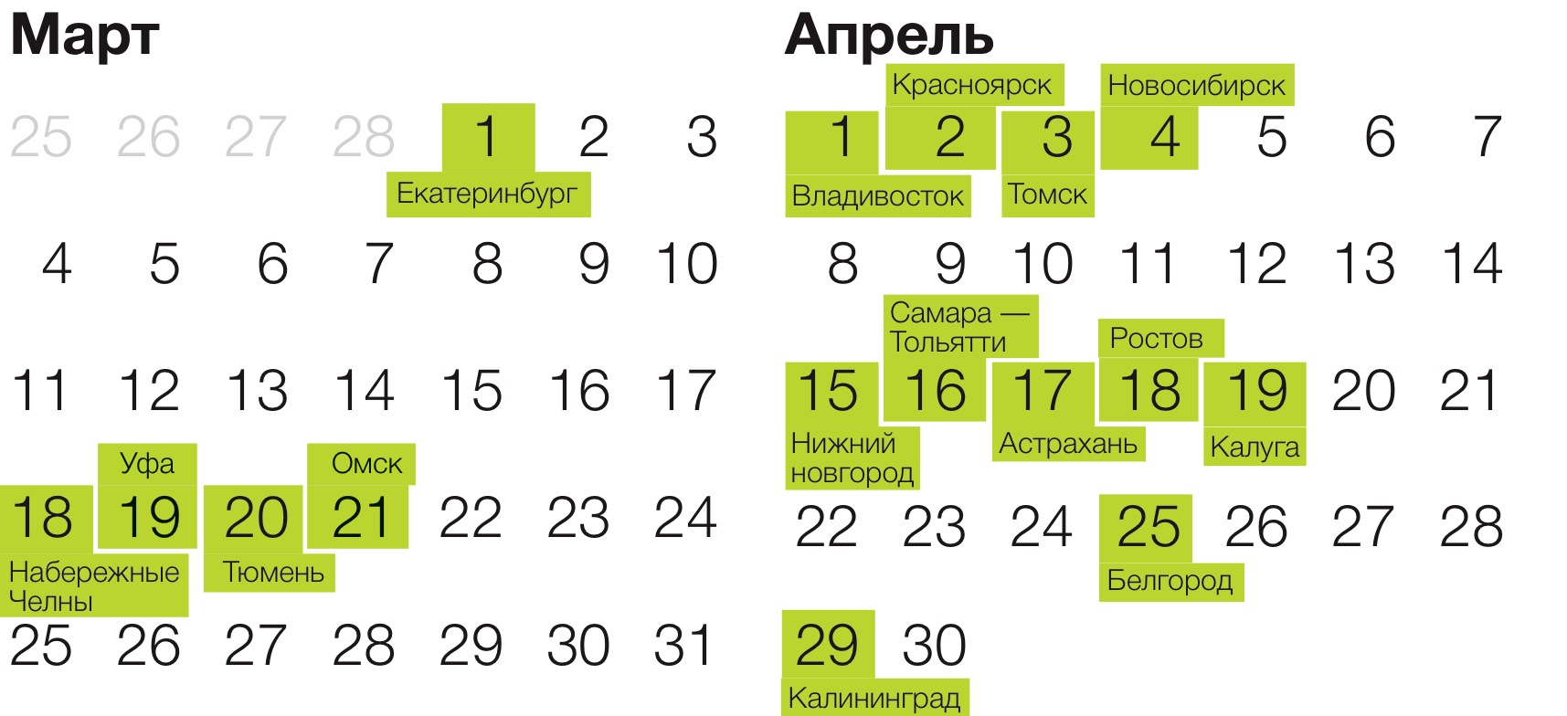
Main Results of Skolkovo Foundation Activities
Key Events
Popularizing Entrepreneurship
On February 10, 2013, the international conference ROBOTICS was held in the cube, the focus of which was space, personal and service robotics.
March 1 was the beginning of the Road Show with development institutions, the goals of which are:
Searching for active leaders for building communication
Combining talent and resources from different cities
Promoting entrepreneurship in the regions
Promotion of projects for foreign investors
Involvement in the startup community of at least 500 participants in each city
The road show will visit 17 cities in Russia
On February 28, 2013, the first meeting of the Venture Fund Council, which includes the heads of 12 venture capital investors most actively collaborating with the Foundation, was held. The council was established to coordinate relations with the investor community and to synchronize the activities of the ecosystem with the goals of accredited venture capital funds.
On March 1 the KNS held its first meeting this year, during which it examined: the report on the activities of the Foundation, a report on the development strategy of Skoltech, approaches to assessing the success of participants, the report of the Grant Committee, the EE cluster, the working group on the interaction of the KNS and Biomed cluster.
The Skolkovo Start-up Village was announced, will start in May 2013

Slide 4
1. Participants
Strategic Goal
Effectively manage the portfolio of innovative projects and guarantee their cooperation with each other and with key elements of the innovation ecosystem
KPI | Целевое значение | Результат на 28.02.2013 | Management Commentary
The number of applications for intellectual property created as a result of innovation at Skolkovo (including matter subject to copyright). | 100 | 12 | In February seven applications for intellectual property rights were filed. Over 2 months, 12% of the target was reached. The largest number of applications were related to "Energy efficiency" (42%), "Information Technology" (33%), "Biomedical Technology" (25%).
The share of external co-financing for projects attracted by participants, in % | 50% | 44,4 % | 44.4% - the total contribution of external co-investors with respect to the total estimates of innovative projects approved in 2013 to receive grant funding from the Foundation. Since the beginning of the year, 5 grants were approved, two of which are stage 2, the requirements for co-financing of which, in accordance with the grant policy, is 50%, and 3 were stage 1, the co-financing requirement for which is 25%.

Slide 5
2. Partners
Strategic Goal
Use the skills and resources of partners to develop research infrastructure and support for participants in commercialization and integration of innovations from participating companies into global technological chains
KPI | Целевое значение | Result on 28.02.2013 | Management Commentary
Number of jobs created in R & D centers of key partners, the formation of which was agreed on at Skolkovo | 500 | 286 | The number of jobs in R & D centers increased by 42 due to the conclusion of agreements with Tatneft, Boeing and Samsung. Collectively, the total number of jobs in the R & D centers will be 230 by 2015 . In progress: agreement with Transmashholding (total number of jobs by 2015 - 450).
The involvement of venture capitalists (VC): The share of investments from accredited VCs of the total investment in participants with respect to the proportion of participants that have attracted external funding from partners,% | 20 | 35 | KPI is taken as the average of two indicators: The share of investments by accredited venture capital funds in the total amount of co-financing of participants. This indicator reflects the statistics of two months of work in 2013, and is 60.41%. The high value was achieved by major investment by the fund Bioprocess, approved in early 2013. The share of participants supported by accredited foundations out of the total number of participants. This figure is 9.46% and corresponds to the average level of 11.9% in 2011-2012.

Slide 6
3. City
Strategic Goal
To complete the design and construction of the city, scheduled for 2013-2014.
Facility Name | Planned date for completion of the current phase * | Status on 28.02.13 | Management Commentary (including a new construction schedule in the event of deviations from the plan) | Плановый срок сдачи объекта
1. SkolTech Complex | Stage P – July 2013 |  | The project documentation is being prepared by companies Ove ARUP and Herzog & De Meuron | December 2014.
2 .Technopark Complex | Stage P – March 2013 |  | Project documentation prepared by Valode et Pistre, passed into assessment. Selection of a contractor for initial construction being carried out | October 2014
3. Apart-Hotel** | Stage P – February2013 |  | Changing the functional purpose of the buildings from housing to apartment hotels necessitated the adjustment of technical tasks. The new deadline for completion of this stage is April 2013, and the shift does not affect the timing of the completion of building | November 2014.
4. Offices and research centers | Entering operation – December 2012. |  | Complaints related to estimated project cost are being worked on, will enter into operation in March 2013 | December 2012
5. Social infrastructure facilities
5.1. Family Campus | Stage P – October 2013 |  | Tasks for engineering design research prepared. Preparing for the selection of the design organization | October 2014.
5.2. Polyclinic | Stage P – October 2013 |  | Design tasks prepared. Preparing for the selection of the design organization | October 2014.
* For the composition of the stages and status symbols, see the Appendix (page 22)
**Apartments 9 - 11

Slide 7
3. City
Strategic Goal
To complete the design and construction of the city, scheduled for 2013-2014.
Facility Name | Planned date for completion of the current phase * | Status on 28.02.13 | Management Commentary (including a new construction schedule in the event of deviations from the plan) | Scheduled date of completion
6. Central Zone | Stage P – September 2013 |  | Design task prepared, selection for design organization being carried out | September 2014
7. . Citywide systems engineering - technical support
7.1 Phase 1 “Bulvar” | End of Construction – December 2013 |  | According to the schedule, construction being carried out by Moskapstroy | March 2014.
7.2 Phase 2 “Parkway” | Stage P – March2013 |  | Design being developed by Gorinzhproekt, a portion of the documentation submitted for assessment | March 2014.
8. Complete landscaping and gardening | Stage P – September 2013 |  | Design being developed by Gorinzhproekt | September 2015

Slide 8
4. Foundation
Strategic Goal
To complete the design and construction of the city, scheduled for 2013-2014.
KPI | Target Value 2013 | Result on 28.02.2013 | Management Commentary
The average time for taking decisions on or calendar days: A) participant status with procedure for prior approval completed B) status of the participant without prior approval C) grants to participants | А) 40 B) 25 C) 50 | А) 30 B) 27 C) 79 | Deviation of actual results from the targets for decisions, are connected with the small number of applications received (4 for participant status, without prior approval, and 5 approved applications for receiving grant financing. On the other hand, a portion of applications were filed in the last days of 2012 and the consideration for them was completed only in 2013, which resulted in an increase of consideration time due to public holidays.
Compliance with the budget of the Foundation (excluding the budget for the construction of innovative city),% | -10% | -70% | Implementation of the budget on 28.02.2013 is 30% of the budget for 2 months because of the small number of working days in the January-February period .

Slide 9
5. Skoltech
Strategic Goal
Ensure the provision of services by MIT
KPI | Target Value | Result on 28.02.2013 | Management Commentary
Ensure recruitment of professors, heads of research centers of Skoltech, with whom cooperation agreements have been signed | 8 | 0 | Two contracts are in the final stage of approval, and a pool of 25 candidates, with whom negotiations are underway, has been formed.
Ensure the formation of the structure of the Skoltech professional community | 278 people. | 92 people. | The Skoltech payroll is at 33% of the resource plan for the number of employees by the end of 2013. At the moment ,58% of the faculty and senior management are foreign nationals.

Slide 10
6. Community
Strategic Goal
Create a non-material environment and design of social infrastructure for the emergence of the Skolkovo innovation community and the constant influx of talent from outside
KPI | Target Value | Result on 28.02.2013 | Management Commentary
Percentage of attracting new members in the online community (the ratio of registered accounts to the total number of unique visits),% | 1.5% | 1.11% | In December 2012 the figure was 1%. The growth of registrations in February was 674, which is projected to lead to the planned value (1.5%) in December 2013.

Slide 11
Appendices

Slide 12





Appendix 1. Dynamics of Participant Attraction
Total number of
participants on
28.02.2013
31.01.2013
TOTAL
824
857
195
203
195
258
273
224
230
67
68
80
83
Number of applications for participant status and preliminary expertise for the total period of the project was 4,355, of these 277 were from the first 2 months of 2013

Slide 13
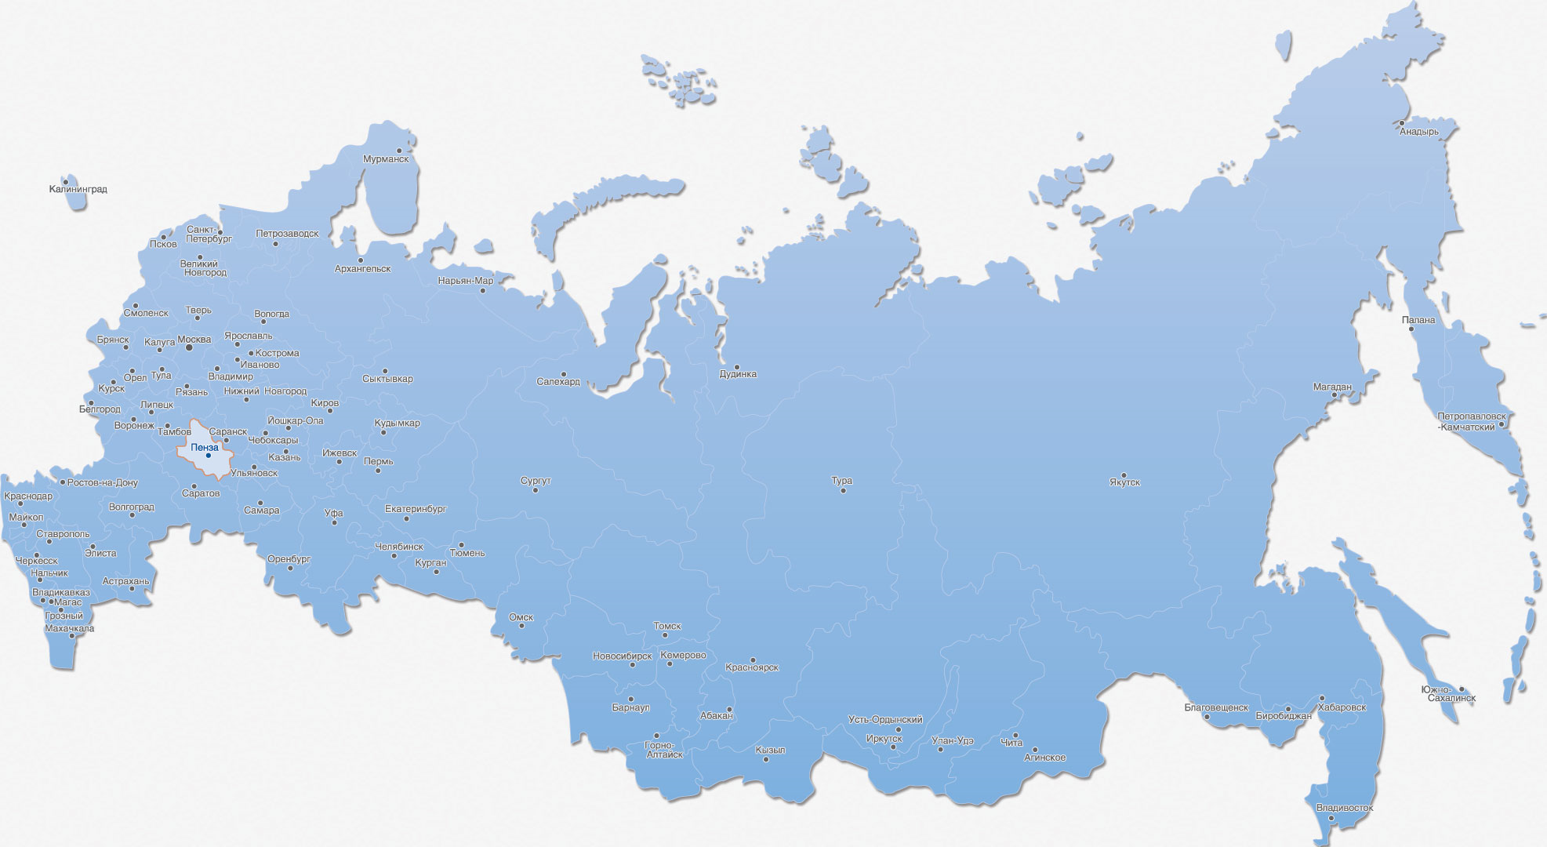
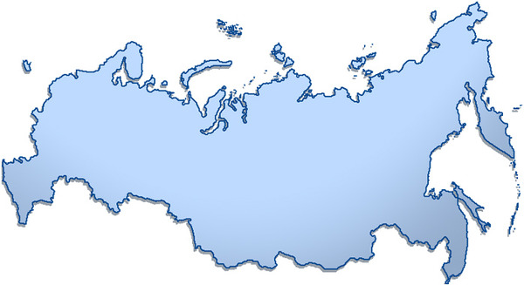
Appendix 2. Territorial Scope of Participants
Astrakhan | 5 | Omsk and Oblast | 3
Bryanskaya Oblast | 1 | Orel | 1
Vladivostok | 1 | Penzenskaya Oblast | 1
Vladimir | 2 | Perm | 7
Volgograd | 1 | Petrozavodsk | 1
Voronezh | 2 | Rostovskaya Oblast | 1
Ekaterinburg and Oblast | 25 | Ryazan | 2
Ivanovo | 1 | Samara | 3
Izhevsk | 1 | St. Petersburg | 90
Irkutsk | 2 | Saransk | 4
Kazan and Tatarstan | 23 | Saratov | 6
Kaliningrad | 1 | Stavropolskii Krai | 1
Kaluga and Oblast | 4 | Syktyvar | 1
Kemerovo | 3 | Tver | 2
Krasnodar and Krai | 3 | Tomsk | 20
Krasnoyarsk and Krai | 13 | Tula | 1
Lenindradskaya Oblast | 1 | Tyumen | 1
Moscow | 486 | Ulyanovsk and Oblast | 3
Mosckovskaya Oblast | 73 | Ufa and Bashkortostan | 5
Nalchik and Kabardino-Balkariya | 2 | Cheboksary and Chuvashiya | 2
Nizhni Novgorod and Oblast | 12 | Chelyabinsk and Oblast | 9
Novosibirsk and Oblast | 26 | Yaroslavl and Oblast | 4
ИТОГО |  |  | 857
Total subjects of the Russian Federation represented | 44

Slide 14
Appendix 3. Participant Grants
Approval and disbursal of grants by year *, mln.
Total,
Million rubles.
Sum of Approved Grants
9 274,7
Total of disbursed grants
5 308,4
* Accounting for the changes resulting from the acceptance of reports
Approval and listing of grants in 2013 by cluster, mln. rubles
The number of grants approved for disbursal for the entire period of the project amounted to 192, 84 of these were mini grants
The average share of co-financing for the entire period of the project was 43.8% with the CPS and 45.8% excluding the CPS

Slide 15
Appendix 4. Attracting venture capital and co-financing
Total agreements
on accreditation
bln. rub.
Binding agreements* signed on investment bln. rub
20
1,0
Of those, with foreign
Companies, billion rubles
List of accredited investment funds
Russian Funds (31) |  | Foreign Funds (19)
FPI RVC | Tatarstan IVF | Exigen | BVP
UK Leader | NAVI | Pangaea | Russia Partners
VTB Capital | Leta Group | I2BF | Oxford Bioscience
Bioprocess | Bright Capital | Fleming | Garage
Biofund RVC | iTech Capital | Sofinnova | Columbus Nova
Maxwell | Troika Dialogue | E.Ventures | Helix Ventures
C-Group | Bin Finam | Inerjys | Intel Capital
Allianz Rosno | Rus-Invest | Quadriga | Alloy Ventures
VEB-Innovation | Trinfiko | Fjord | Wermuth
Sberinvest | Indigo Capital | Tamir Fishman
Foresight | Dauria
Almaz Capital | FPPI
Runa | Frontier
Softline | Yakutia
Amhurst Capital | Prostor Capital
UK Univer
6,8
0,45
The number of participants supported by accredited funds
81
Of these, foreign funds
12
Evaluation of soft commitments from accredited corporate venture funds before the end of 2015, mln.
3 000
Of these, soft commitments of foreign funds, mln. rub
1 050
* Co-financing under the grant agreements
** Bold funds established with the participation of "RVC"

Slide 16
Appendix 5. Key Partners
Number of key company partners of the Skolkovo foundation | 30
The number of corporate R & D centers planned to be deployed in Skolkovo | 25
Estimation of the number of employees in R & D centers in 2015, pers. | 2689
Evaluation of the total budget of R & D centers by the end of 2015, mln. Rubles | 27 845
Assessment of the current number of employees in R & D centers | 286
The number of corporate venture capital funds financing Skolkovo participants (NAVI and Columbus Nova (GC "Renova»), Intel Capital (Intel)) | 3
List of key partners for the Foundation**
Nokia Corporation | KAMAZ
Siemens | RU-COM
Microsoft | OSK
EADS | HC "Composite"
Ericsson | ISS im.Reshetneva
General Electric | AFK Systema
Nokia Siemens Networks | Renova
Cisco | Boeing
EMC | TNK-BP
Schneider Electric | State Corporation "Rosatom"
Honeywell | Lukoil
Alstom | TATA
Intel | Johnson&Johnson
IBM | Samsung
SAP | Tatneft
**international companies shown in bold text
Of the 30 key partners there are 17 major international companies planning to build R & D centers in the Innovation Center. The total number of staff in 2015 will amount to 1,618 people, and the amount of funds invested to 2015 will be more 16,711,313 thousand rubles
*Most of the key partners are developing in several different areas at once

Slide 17




Appendix 6. Applications for intellectual property
Results on 28.02.2013 |  |  |  |  |  | TOTAL
Applications filed: | 4 | 5 | 3 |  |  | 12
Invention or utility model, the Russian Federation and international | 1 | 3 | 2 |  |  | 6
for trademark registration | 3 | 2 | 1 |  |  | 6
for registration of computer software
Number of applications for IP work | 5 | 5 | 1 |  |  | 11
Plan for next month:
Submission of applications for IP – 8

Slide 18
Appendix 7. Key Events of the Foundation
12.02
Russian-American video conference "How to organize a startup“ held at the Skolkovo Technopark
19.02
The Foundation Investment Service held an active working session tele-meeting at the tecnhopark with Skolkovo participants from St. Petersburg and Yekaterinburg
A pitch-session and networking event attended by accredited venture capital funds was held for nineteen residents of the IT cluster
February 2013
28 | 4 | 11 | 18 | 25
29 | 5 | 12 | 19 | 26
30 | 6 | 13 | 20 | 27
31 | 7 | 14 | 21 | 28
1 | 8 | 15 | 22 | 1
2 | 9 | 16 | 23 | 2
3 | 10 | 17 | 24 | 3
14.02
The Skolkovo Foudnation and Cisco IBSG presented the results of a joint study: "Identifying and measuring the growth of the Russian economy depends on the degree of development of clusters"
A conference titled "Regenerative medicine in Russia« was held in the Hypercube
21.02 An event was hosted in the Hypercube: "Skolkovo and Special Economic Zones – determining the format of mutually beneficial cooperation in the commercialization of innovation"
10.02 International Skolkovo Robotics conference was held in the Skolkobo Hypercube

Slide 19




Appendix 8. Participant Success Stories (1/2)
The Center for Applied Research of Computer Networks will receive a grant from the Ministry of Education and Science of the Russian Federation in the amount of 5 million rubles for the creation and development of a national platform of open source management software for managing software configurable networks (SCN)
Essence of the Innovation
The main task of the center under this contract is an assessment of the possibility of using SCN technology to improve management of computer networks in data centers (DC)
The result will be a prototype research tool for managing network resources and data flows in data centers based on the SCN approach with distributed network operating systems
In the case of successful R & D, the result will be the first Russian switchboard for software-configurable networks (PKS), application development tools for PCB-based networks, systems for control and safety in PKS-based networks, intrusion detection for cloud platforms, means of virtualization of data systems for data centers and cloud computing
Intersoft Eurasia (operator of the DO-RA project) and
U.S. company Predicus signed a long-term contract (10 years old) on strategic partnership
Essence of the Innovation
The DO-RA project is a mobile radiometer on a mobile phone (smartphone) using a unique detector of hard alpha-, beta-and gamma-rays.The DO-RA control system works with specially designed software packages and through a licensed operating system used by mobile devices
The sensor is based on semiconductor detectors and may be built into the telephone circuit or used as an additional device. The latest version of the device works via USB-port, or remotely (via Bluetooth or Wi-Fi), thus creating a modular mobile dosimeter-radiometer

Slide 20



Appendix 8. Participant Success Stories (2/2)
A series of documents for the ALLTECH group joining the mini-GTL project (small-sized plant for processing into synthetic crude oil) Gazohim Techno. The partner brings to the project not only significant financial resources, but also key business-building expertise in the oil and gas industry
Essence of the Innovation
A joint Russian-British project, in which the achievement of technological and economic synergies is achieved by combining two innovative blocks in a single installation - POX (partial oxidation) from Gazohim Techno and a microchannel Fischer-Tropsch reactor from the Oxford Catalysts Group
The purpose of the project is the commercialization of mini-GTL technology - Creating the world's first viable small-scale GTL plant , capable of effectively monetizing the small gas resources from raw materials (associated petroleum gas, biogas, methane, natural gas, etc.)
Participant of the Skolkovo Foundation News360 was voted the world's best startup at World Summit Award - Mobile Content
Essence of the Innovation
News360 is a set of applications that exist for all popular tablets and smartphones that helps users find the most interesting and important news on the Internet. The application is built on the basis of its own analytical platform that allows the aggregation of articles from hundreds of thousands of online sources and sorted in accordance with the preferences of readers
News360 has already been installed by more than 2 million people and is one of the most highly valued by users of news apps

