Slide 1
BIOTECH Invest workshop, Skolkovo
Evolving Models of Innovation for Breakthrough Medicines: New Concepts at Pfizer
28th May, 2012

Slide 2
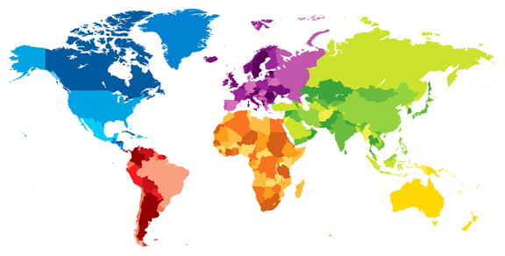
Pfizer Snapshot
~$67 Billion combined revenue in 2011
89 Manufacturing sites worldwide
12 Products with sales greater
than $1 Billion
#1 Primary and #1 Specialty Care
and #1 Animal Health company
Major R&D operations and partnerships
in US, Europe, Canada and China; 250 R&D partners
Over 60 products with sales greater
than $100 Million
Over 100,000 colleagues worldwide
A medicine portfolio that helps prevent
disease and promote better health at
every stage of life

Slide 3
Pfizer is Composed of Nine Diverse Businesses Supported by Two Focused R&D organizations
Pfizer BioPharmaceutical
Businesses
Pfizer Diversified Businesses
Primary Care
Specialty
Care & Vaccines
Est. Products
Emerging Markets
Animal Health
Consumer Health
Nutritional Health
Sold to Nestle
Oncology
Worldwide Research & Development
(incl PharmaTherapeutics, BioTherapeutics, Oncology, Vaccine, Biotech Units)
Business Units
Development
Medical
Sales & Marketing
Manufacturing
Supporting Functions (e.g. Legal, Finance, HR, BT)
Notes:
2
2
2

Slide 4





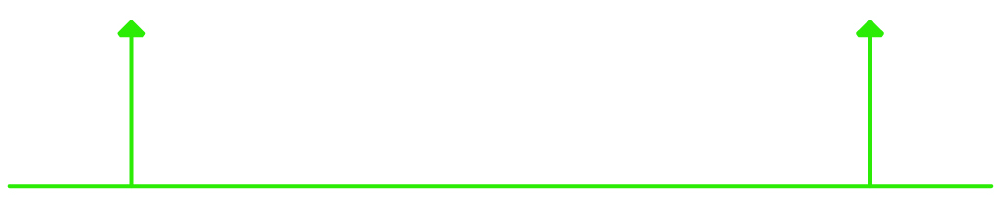




A Uniquely Comprehensive Effort to Strengthen the Innovative Core
ESI: Engine for Sustainable Innovation
Greater Focus
to strengthen
our scientific core
Strategic Externalization for competitive advantage
Differentiated Innovation
through culture, leadership, Precision Medicine
Quality of Output
Probability of Success
Speed
Cost
Notes:
Scientific excellence is meaningful when it leads consistently to important product launches. Our operating model improves our dialog and interface between R&D and Commercial to better connect the science with the business strategy and the business outcome.
Within our current operating model, WRD is accountable for delivering robust proof of concept molecules to the BUs, who then determine whether and how to take them through Registration.
But the interaction is vigorous at an early stage. We begin engaging early with the BUs to discuss and align on asset level strategies and criteria for success (both scientifically and commercially) – so, by the time we reach the POC milestone there is a clear understanding of the potential of each asset to guide the phase 3 investment decision.

Slide 5

The Pfizer Pipeline Status
DISCOVERY
PHASE I
PHASE II
PHASE III
REGISTRATION
Compounds show promise in labs; lab experiments begin
Experimental medicine tested for first time in human clinical trials
Trials focus on medicine’s effectiveness; determine ideal dosage and delivery method
Test results of earlier trials on larger populations in randomized trials; analyze risks/benefits
When trial results warrant, file application with the right regulatory authorities
PHASE I
PHASE II
PHASE III
Registration
TOTAL
Discovery projects
26
35
18
11
90
Pfizer pipeline as of February 28, 2012
Notes:
As of September 27, 2010, Pfizer’s development pipeline includes 118 programs, from phase 1 through registration – across a broad range of diseases
Our pipeline demonstrates focused investment in our six “Invest to Win” areas of research — oncology; pain; inflammation; Alzheimer’s disease; psychoses; and diabetes — as well as growth in the critical technologies of vaccines and biologics.
The growth in vaccines and biologics reflects Pfizer’s goal of becoming a top-tier biotherapeutics company by 2015 and the company’s pipeline now includes a total of 6 vaccines and 27 biologics in development, up from 1 vaccine and 16 biologics at the last pipeline update in March 2009. (Much of this growth is due to Pfizer’s acquisition of Wyeth)
Pfizer’s portfolio also includes:
30 compounds in development for various oncology indications
10 compounds in development for Alzheimer’s disease, representing a range of mechanisms Pfizer is evaluating for the treatment of this illness
8 compounds in development for pain
And 11 compounds in development for inflammation
In-line with our November, 2009 announcement that we would reduce our global R&D square footage by 35 percent, Pfizer’s ongoing R&D activities will be conducted at five main sites and nine specialized units around the world

Slide 6
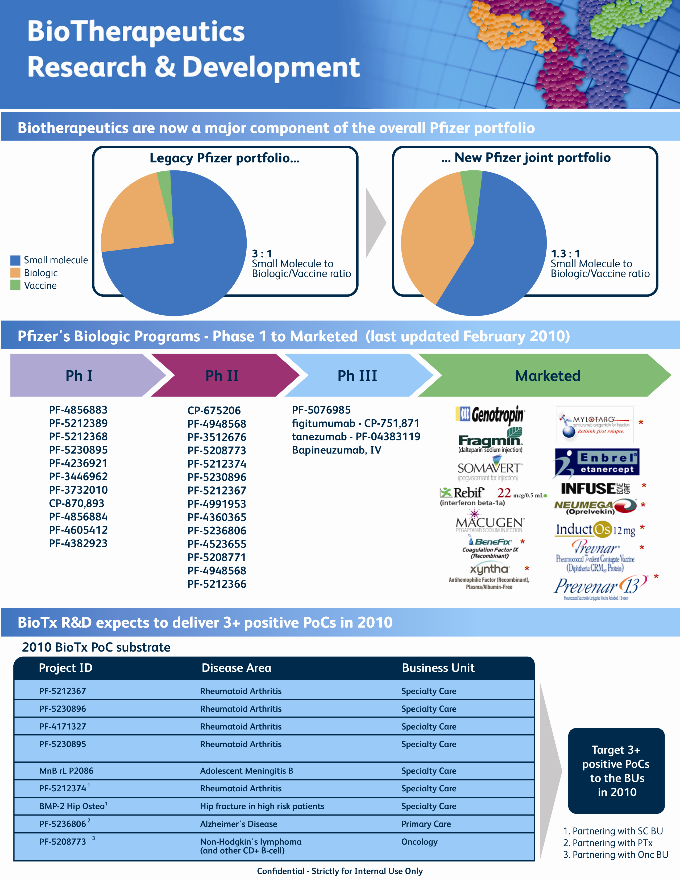

Acquisition of Wyeth Established
Pfizer as a leader in Biologics & Vaccines
Pfizer R&D Pipeline Update as of January 27, 2010

Slide 7

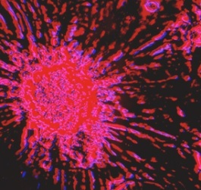
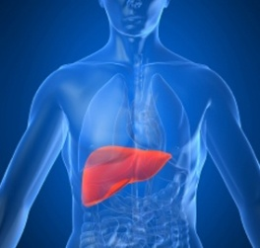
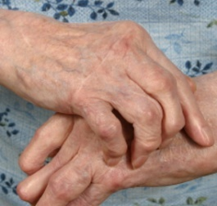
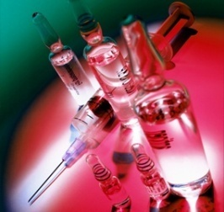
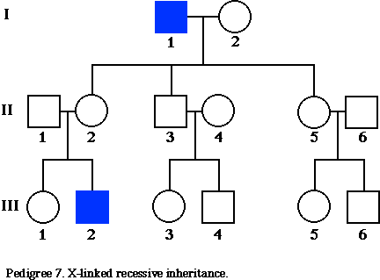
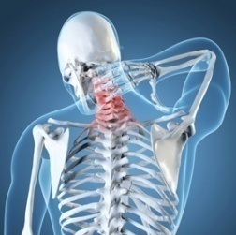
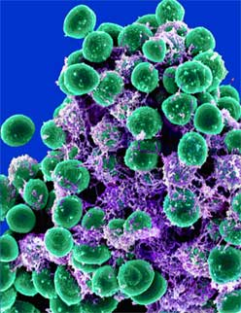
Pfizer Major Research Focus Areas
R&D Core Areas
Neuroscience
Oncology
Cardiovascular, Metabolic & Endocrine Disease
Inflammation & Remodelling
Immunology & Autoimmunity
Vaccines
Specialized Areas
Orphan & Rare Diseases
Pain & Sensory Disorders
Biosimilars

Slide 8
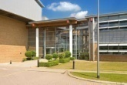
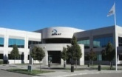
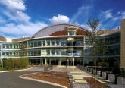

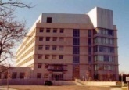

Pfizer WRD Footprint
- Aligned with Scientific Hubs -
Cambridge, UK (Neusentis)
Groton, CT (CoE, Med Chem, Pharm Sci, DSRD)
Andover, MA (GBT)
Cambridge, MA (I&I, CNS, CVMED, OGD)
Pearl River, NY (Onc, Vac)
San Francisco (Rinat)
La Jolla, (CovX, Onc, Vac)
7

Slide 9
Open and External Innovation:
Combine the best science
from internal and external sources
“Not invented here” mentality no longer viable
Key challenge: identify & harness external innovation with the right quality and strategic fit (bi-directional)
Dedicated efforts to identify, assess, and integrate top quality external assets, technologies & scientific know how
External R&D Innovation (ERDI)

Slide 10
Accessing the Best Science and Assets globally
Defining WRD needs for breakthrough technologies, pre-clinical & clinical assets, and cutting edge science
  Pfizer WRD Partnering Brochure and website
www.pfizer.com/WRDpartnering

Slide 11
Accessing the Best Science and Assets globally
Defining WRD needs for breakthrough technologies, pre-clinical & clinical assets, and cutting edge science
  Pfizer WRD Partnering Brochure and website
Identify opportunities globally based on mutual scientific interest and complimentary approaches
  Leverage Pfizer global network
www.pfizer.com/WRDpartnering

Slide 12

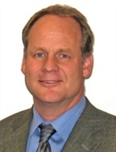







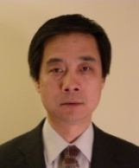

Global Scouting Network established
– Leveraging Pfizer’s Global Structure
Vancouver
British Columbia
Montreal
Quebec
Toronto
Ontario
Cambridge, UK
Pain RU
Cambridge, UK
Epigenetics
Moscow
Eastern Europe
San Francisco
Northwest
NYC, NY
Paris
Europe
Bangalore
SRP India
La Jolla
Southwest
Cambridge, MA
SRP - Asia/Pacific
Sao Paulo
Brazil & South-America
Shared Coverage in Brazil, Canada, China, Germany, India, Israel, Japan, Russia and Turkey
Sourcing of academic/biotech deals
Seed-stage investments
Facilitate visiting scientist programs
Support regional partnerships
Melbourne, AUS
SRP Australia

Slide 13
Accessing the Best Science and Assets globally
Defining WRD needs for breakthrough technologies, pre-clinical & clinical assets, and cutting edge science
  Pfizer WRD Partnering Brochure and website
Identify opportunities globally based on mutual scientific interest and complimentary approaches
  Leverage Pfizer global network
Apply flexible partnering models as appropriate
  Research Collaborations, Consortia, Incubations, Licensing, Acquisitions, etc.
  Centers for Therapeutic Innovation
www.pfizer.com/WRDpartnering

Slide 14
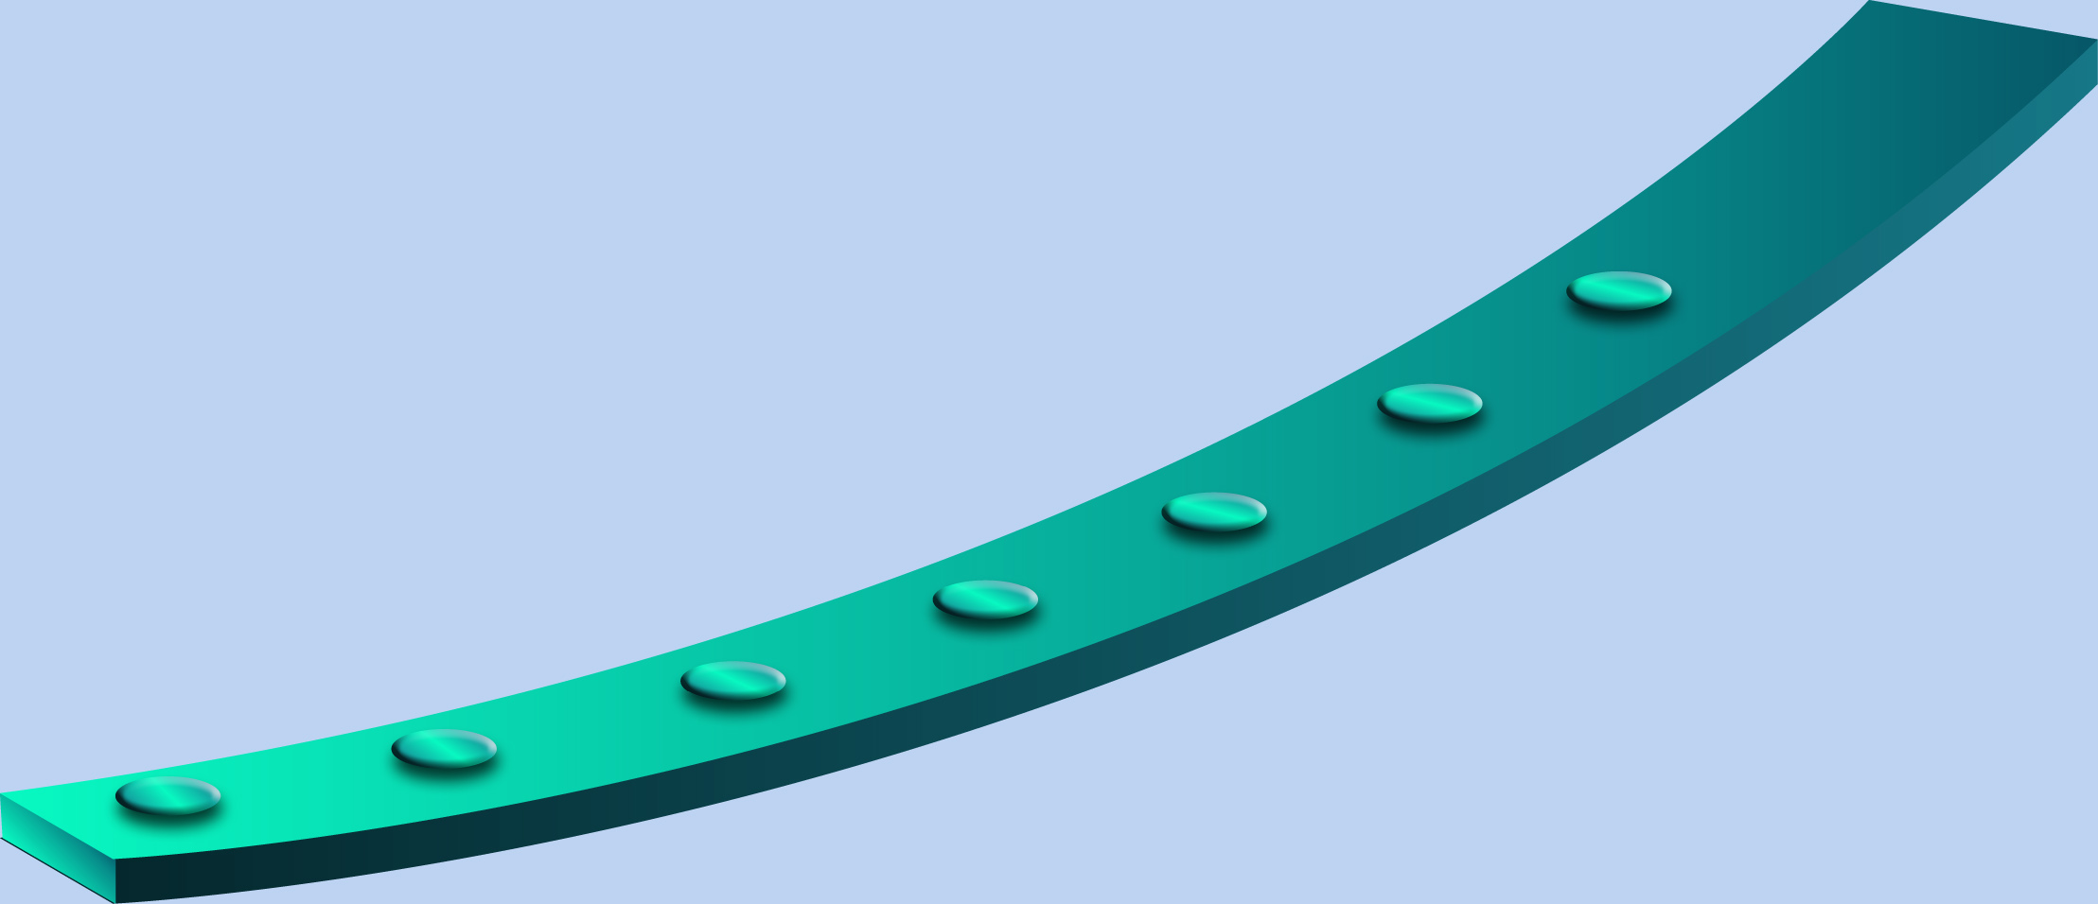
…And a Commitment to Flexible Working Relationships
Mergers & Acquisitions
Licenses
Venture Investments
Research Collaborations & Alliances
Out Licenses
Co-Promotion, Co-Development
Incubator

Slide 15
Committed To Partnering Through Responsive
and Flexible Transaction Structures*
Archemix
Abgenix
Catalyst Biosciences
Direvo
FivePrime
Hydra
Icagen
KaroBio
Medarex
Melior
MorphoSys
Noxxon
Renovis
Scripps
Tacere
Trubion
WHO
Bayer
Celldex
Cytos
FivePrime
Incyte
Kosan
Quark
Rigel
Santaris
Schwarz
Scil
Sigma Tau
Taisho
Tacere
TransTech
UCB-Celltech
Xoma
Amgen
Astellas
Boehringer Ingelheim
Bristol-Myers Squibb
Eisai
Elan
Eyetech
Janssen AI
King
Medivation
Medtronic
Nycomed
Serono
Taiho
Bioren
BioRexis
Coley
CovX
Encysive
Esperion
Haptogen
Idun
Meridica
PowderMed
Rinat
Serenex
Thiakis
Excaliard Pharma
Cordis
DOV
The Medicines Company
Debio
RaQualia
Esperion II
Profectus
Tanox
Vascular Therapies
Small molecules
Biotherapeutics
Aureon
Avid Radio-Pharma
Aviir
Entelos
Evolution Benefits
Genomic Health
Handylab
HD Biosciences
M2s
Nodality
Supplyscape
Out Licenses
Mergers & Acquisitions
Fabrus
RGo
Wintherix
Commercial
Collaboration
Research Alliances
Research Alliances
Venture Investments
Incubator
* Represents a sampling of creative deal structures Pfizer has completed. Deals listed may fit into more than one category noted above
14

Slide 16



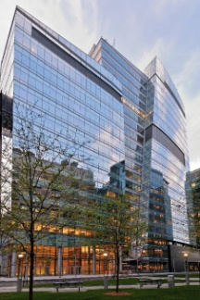






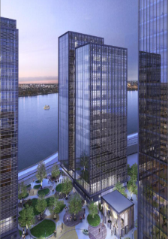










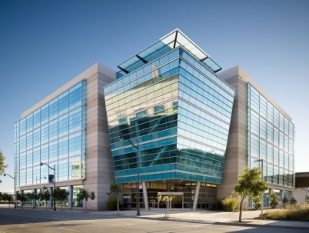
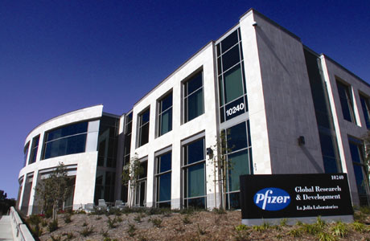

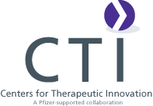
Centers for Therapeutic Innovation (CTI)
CTI-Boston
CTI-New York
CTI-California
Notes:
Strategic externalization is also driven through our Centers for Therapeutic Innovation. The expansion of CTI has given us a presence both in California and on the east coast.
In total we have 19 academic medical centers in the CTI network.
You can see on this slide the outstanding institutions and teaching hospitals that have agreed to partner with Pfizer in the cutting-edge science and clinical research that will set us apart.
After a rigorous review of more than 150 proposals, we’ve selected 14 projects to bolster our portfolio.

Slide 17
Why Partner with Pfizer?
Outstanding R&D capabilities (small & large molecules, Vaccines)
Strong Partner for Drug-Development
Experience in Regulatory, Commercialization
Flexible operating model, emphasizing mutual scientific interests and risk sharing concepts
Notes:
16

Slide 18
How to Partner with Pfizer?
Learn more about Pfizer WRD’s areas of interest for external partnering:
www.Pfizer.com/WRDpartnering
Contact your ERDI representative for your area of interest
www.pfizer.com/WRDpartnering
Notes:
17

