Slide 1
BioFund
Egor Gulyaev
Investment Manager, MBA
May, 28 2012

Slide 2



RVC Biopharmaceutical Investments Fund
Full title: RVC Biopharmaceutical Investments, ltd.
Abbreviated title: RVC BioFund
Initial capital: | RUB 500 m
Target capital: | RUB 1,5 bn
Fund life: | Unlimited
The cornerstone of the BioFund Investment Strategy is to invest capital of the Fund into stakes:
Russian infrastructure service provides
Innovative companies of Russian biopharmaceutical sector
Investors:
Russian Venture Company (OJSC) 94%
Venture Innovative Fund (Nonprofit organization) 6%

Slide 3
Where do we invest?
Investment Focus
Service companies
Innovative biopharmaceutical companies (IBC)
Contract laboratory services
Contract manufacturing services
Informational and analytical services
Consulting services
Specialized services (including training of managers for infrastructure and service companies) to biotech, pharmaceutical and medical companies
Drug and medical technology developers
Portfolio structure: 50% (+/-20%)
Portfolio structure: 50% (+/-20%)

Slide 4

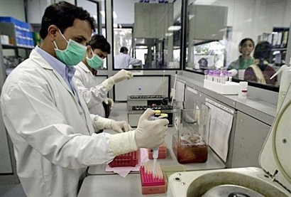
Service Company
BioFund | Private Investor
Up to RUB 100m (~3.3m USD) Not more than 75% of aggregate investment demand in 1 Round Cash, property or IP rights | At least 25% of investment demand in 1Round Cash only
Scheduled break-even horizon | Not more than 7 years
Potential output horizon: | Not later than 3 years after first investments

Slide 5

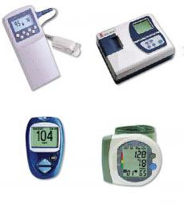
Innovative Biopharmaceutical Company
BioFund | Private Investor
Up to RUB 100m (~3.3m USD) Not more than 50% of aggregate investment demand in 1 Round (max capital – not more than RUB 300m) Cash, property or IP rights | At least 50% of investment demand in 1Round Cash only
Exit horizon: | Not more than 7 years

Slide 6

Structure of a deal
Round 1
BioFund RVC
up to $3,3m
75% of ID
% of shares
Service Company*
GxP quality standard
high-tech research/ industrial equipment
Project Initiator
25% of ID*
~$4,4m (grant)
IP transfer
no financial contribution
% of shares
The requirement for a grant from the Skolkovo
the presence of a specialized co-investor
* Russian legal entity

Slide 7
Thank You!
RVC BioFund
Gulyaev Egor, MBA
Investment Manager
Lesnaya str., 43, Moscow
Russian Federation, 127055
Tel.: +7 (495) 789-69-47
E-mail: info@rvcbio.ru
www.rvcbio.ru

Slide 8
What we are looking for in Service Projects?
Cost of service for Russian clients not more than 2/3 of international contract services
Past experience and accomplishments of the project initiators (participation in CRO, CMO companies from scratch, cooperation and partner relations with international contract service provides)
Small companies that are ready to modernize their production facilities to international standards
The infrastructure platforms with high-tech research/industrial equipment

Slide 9
What we are looking for in Product projects?
Scientific and technological novelty confirmed by a patent/patent application
Solid competitive advantages including replacement technologies
The volume of the potential market – at least RUB 300m
Past experience and accomplishments of the company/project initiators
Good commercialization model

Slide 10
How Can BioFund Invest
Biofund RVC
Project
after DD
Biofund
Investment Committee
up to 75% of ID *
up to 50% of ID*
Service Company**
Investments
IBC Company**
not less 25% of ID*
not less 50% of ID*
Investments
Private Investor
(Russian/NonRussian)
* ID - Investment Demand
** Legal entity in Russia

Slide 11
Movement of a project in BioFund
Project Summary Document (PSD)
First day
Advices from the BioFund to improve or modify PSD
Day 5-7
Improvement of PSD in accordance with the advices from the BioFund
Day 7-30
Consideration of the modified version of PSD by Investment Committee (IC)
Day 31-40
Primary conclusion of the project, advice on writing a business plan
Day 41
Writing a business plan
Day 41-60
Consideration of business pan by Investment Committee
Day 60-70
Due diligence
Day 71-105
Decision form Investment Committee to invest in the project
Day 105-115
Based on results of Investment Committee, the project can be:
Declined
Forwarded for improvement
Sent to the next stage
In reality, terms are strongly dependent on the ability of the team promptly communicate with the BioFund

