Slide 1
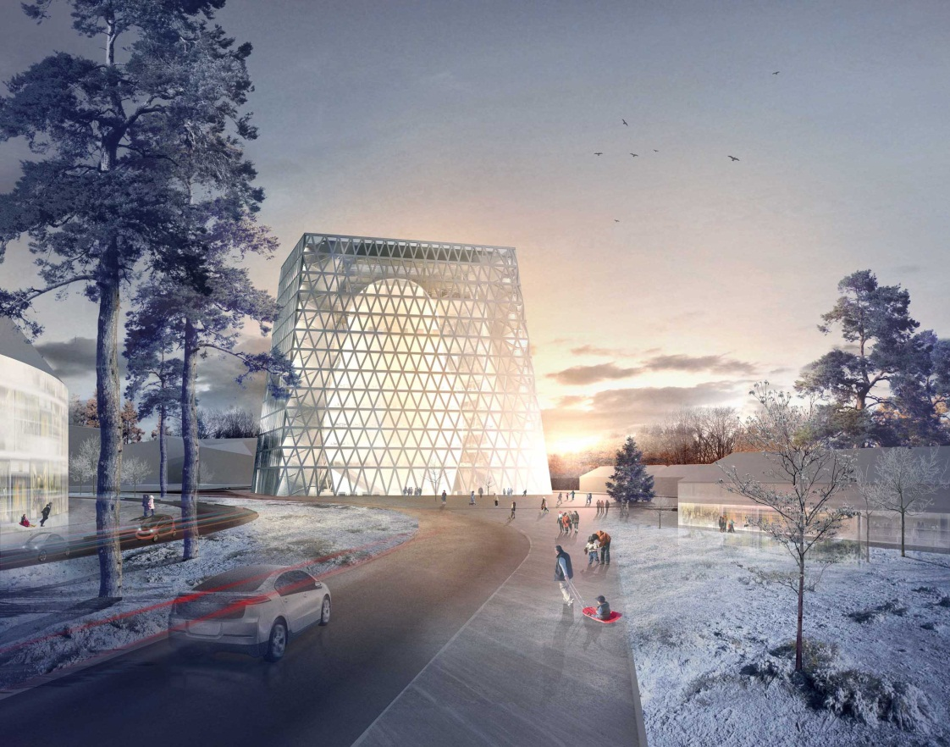
1. “Skolkovo” Business Center («Matreshka»)

Slide 2
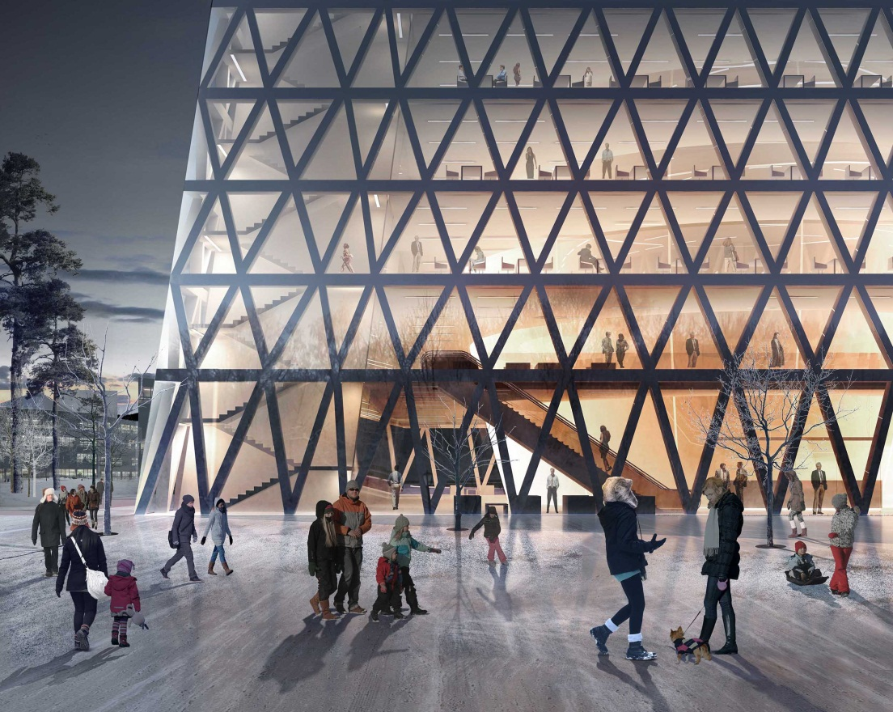
1. “Skolkovo” Business Center («Matreshka»)

