Slide 1
Designing and construction of
Skolkovo Innovation Center
Information for the City Planning Board
29 March 2013

Slide 2
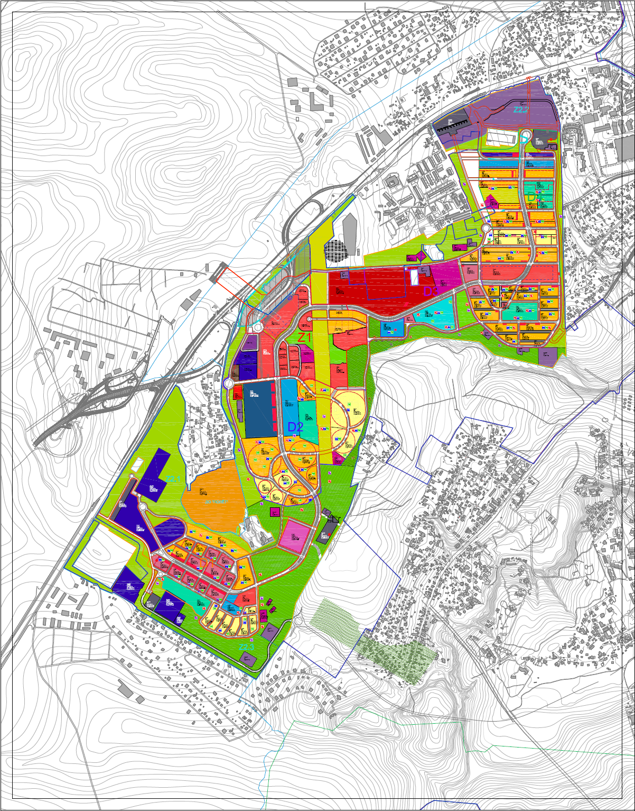
Master Plan
October 5th – Meeting with Deputy Prime Minister resulted in instruction of development conception of the Central Zone
November 16th – The conception was considered by City Planning Board
Object | Construction program, sq. m
 | Total | Foundation | Investors
Skoltech | 128 000 | 128 000
Technopark | 146 000 | 79 000 | 67 000
R&D, offices | 511 000 | 42 000 | 469 000
Apartments | 421 000 | 76 000 | 345 000
Social infrastructure | 156 000 | 44 000 | 112 000
Engineering infrastructure | 50 000 | 20 000 | 30 000
Transportation infrastructure | 199 000 |  | 199 000
TOTAL | 1 611 000 | 389 000 | 1 222 000
Incl. Central Zone (slide 15) | 243 000 | 41 000 | 202 000

Slide 3
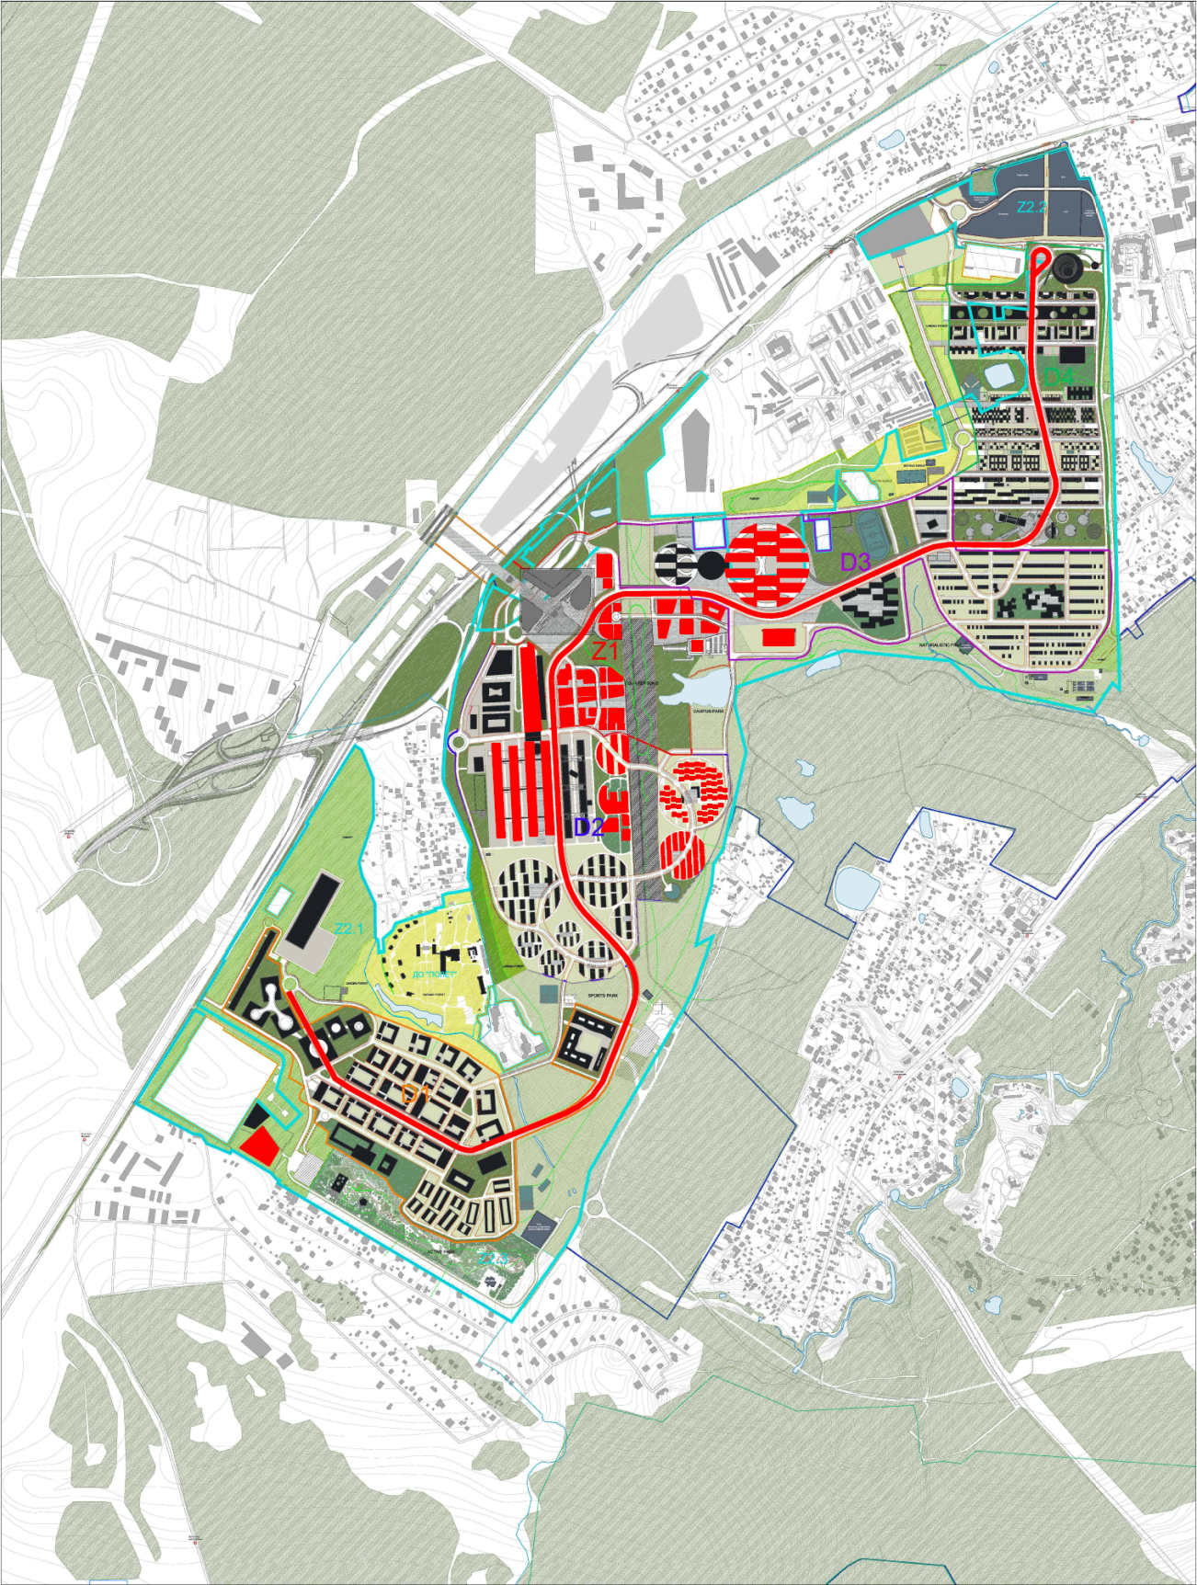
Proekt Planirovki and Initial Objects
Proekt Planirovki of the Innovation Center has been prepared
The initial objects of the Innovation Center defined, designing and construction in process
5
Initial objects
1 | Technopark
2 | Skoltech
3 | Apartments
4 | Hypercube
5 | Utilities, roads
6 | Office center Gallery
7 | Business center Skolkovo
8 | Renova Lab
9 | Central zone
2
9
7
6
4
1
3
5
8

Slide 4
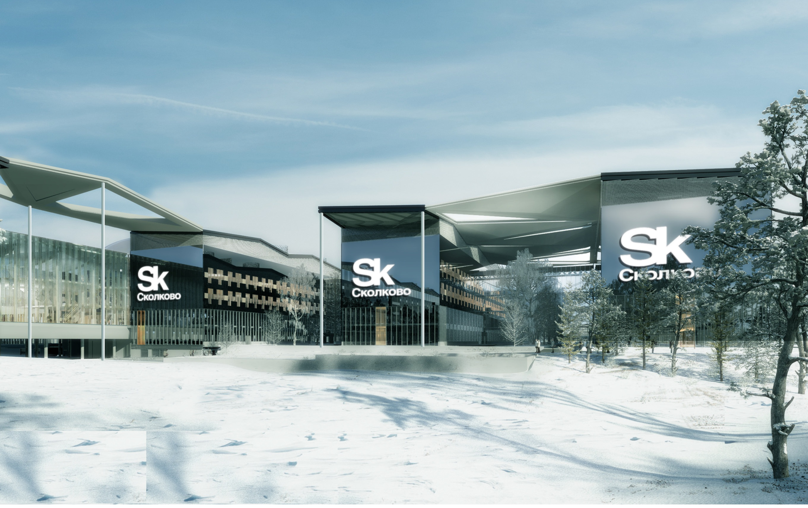
1. Technopark
Stage P in expertise
Pre-construction works contractor is defined

Slide 5
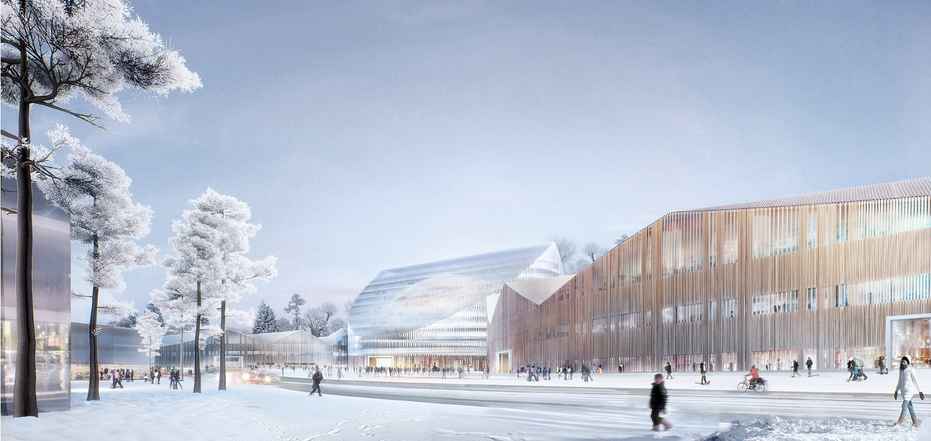
2. Skoltech
Stage P is being developed

Slide 6
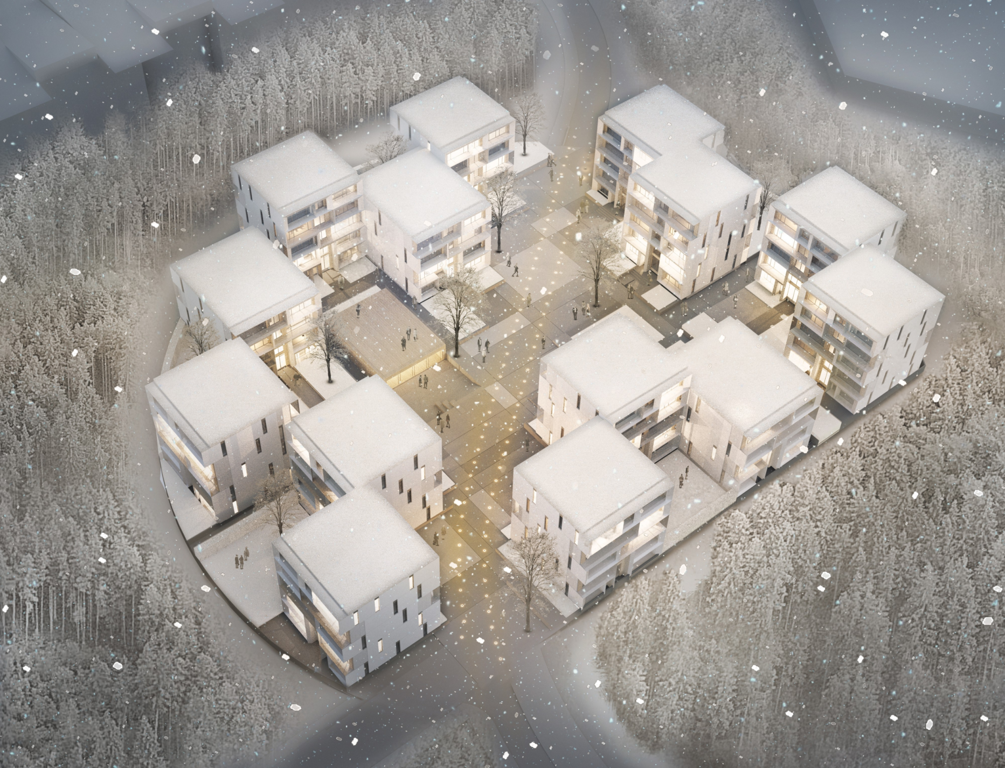
3. Apartments
Stage P to be completed
Pre-construction works contractor is defined

Slide 7
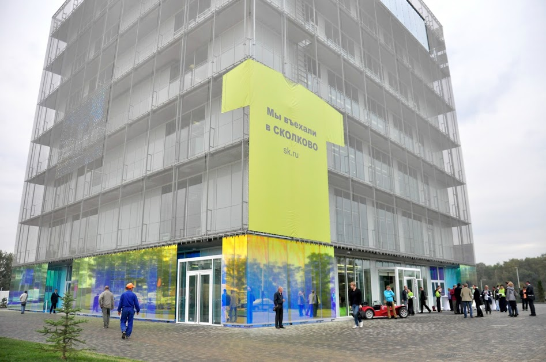
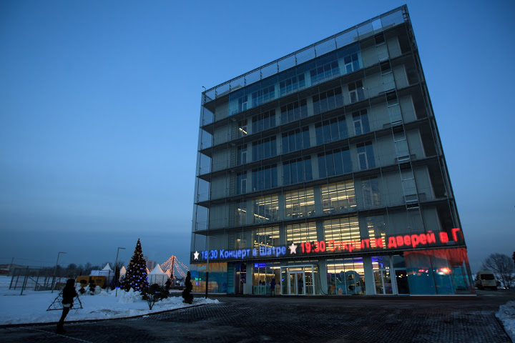
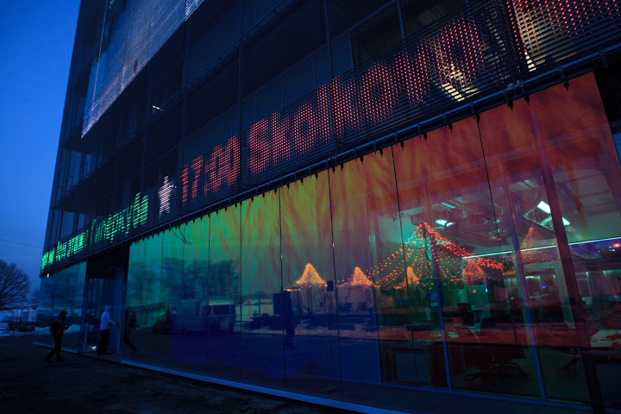
4. Hypercube

Slide 8
5. ENGINEERING SYSTEMS

Slide 9
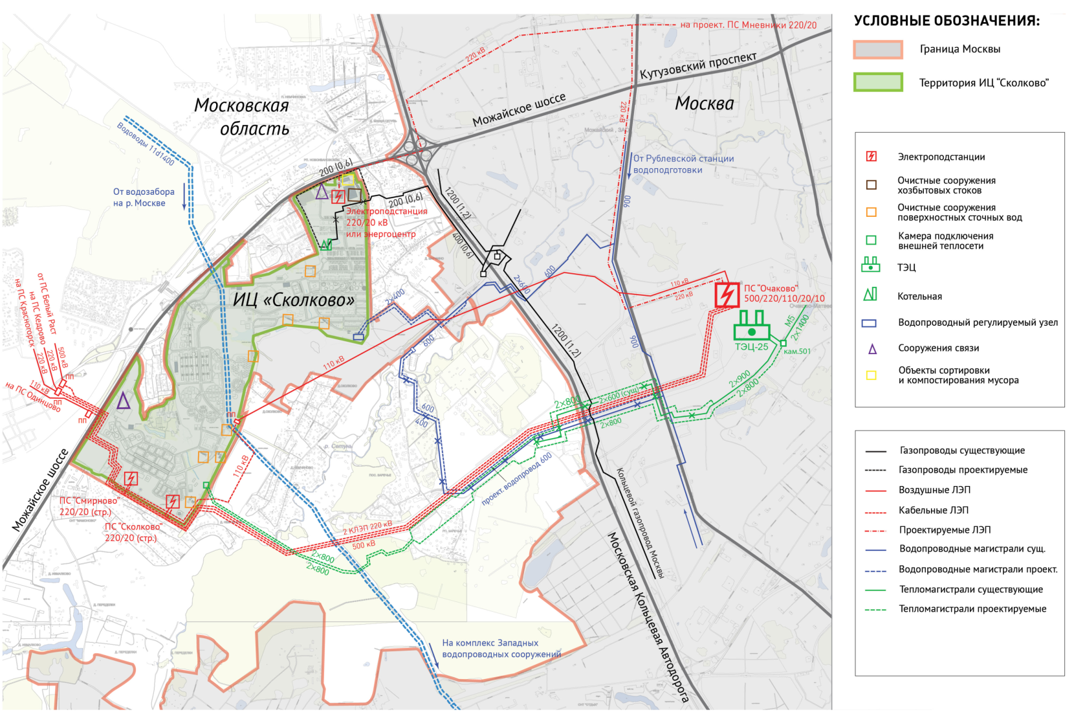

External engineering infrastructure objects
РТС «Кунцево»
 | EXTERNAL OBJECTS AND ACTIVITIES PROVIDING FUNCTIONALITY OF SKOLKOVO IC | Responsible party | Period
 | Engineering infrastructure
1 | Water supply (18 730 cubic meters per day) | Moscow Government | 2013-2014
2 | Heat supply (205 GCal/h) | Moscow Government | 2013-2014
3 | Electricity (126 MVA/107MW) | OJSC «ФСК ЕЭС» | 2014-2015
4 | Telecommunication network | конкурс | 2013-2014

Slide 10
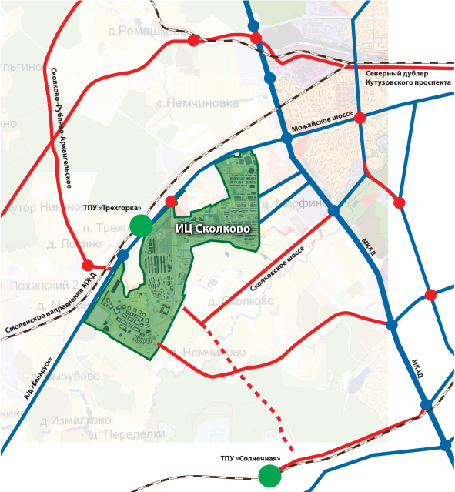
External road infrastructure objects
 | EXTERNAL OBJECTS AND ACTIVITIES PROVIDING FUNCTIONALITY OF SKOLKOVO IC | Responsible party | Start of construction | End of construction
 | Road infrastructure
1 | M1, 17 km | Government of the Moscow Region | June 2012 | December 2013
2 | 52 km of MKAD, Odintsovo district | Government of the Moscow Region | June 2012 | December 2013
3 | 19 km of Mozhayskoe highway | Government of the Moscow Region | June 2012 | May 2014
4 | 50 km of MKAD, Odintsovo district | Government of the Moscow Region | March 2013 | May 2014
5 | Marfino and Nemchinovo to IC Skolkovo | Government of the Moscow Region | August 2013 | December 2014
6 | M1, 19 km | Avtodor | October 2012 | May 2014
7 | M1, 21 km | to be defined | March 2013 | May 2014
8 | Solnechnaya station to IC Skolkovo | to be defined | July 2013 | December 2014
1
6
2
3
5
4
7
8

Slide 11
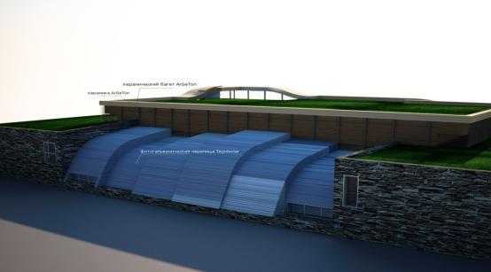
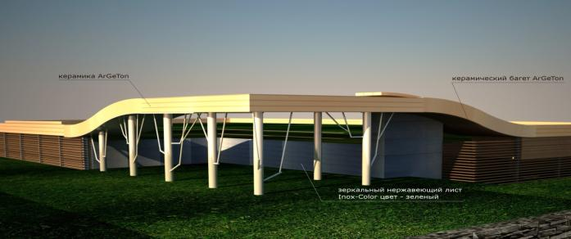
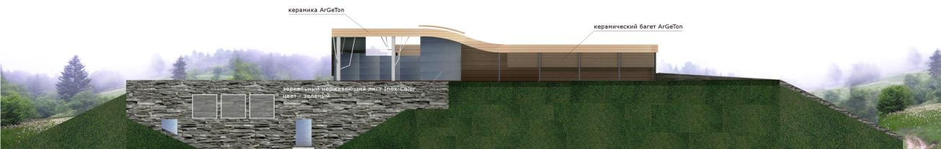
Internal utilities and roads
Main characteristics(executive in charge –UDPS Skolkovo LLC ):
High-level water supply network – 6 470 m
Water supply distribution network – 11 125 m
Head wastewater system – 10 pieces
Trunk sewer network - 9 690 m
Wastewater distribution system – 11 650 m
Stormwater network – 35 420 m
Transmission heat supply network – 19 964 m
Transmission and distribution power network – 689 500 m (executive in charge– OJSC «ФСК ЕЭС»)
Public lighting system – 34 068 m
Roads – 28 088 m

Slide 12
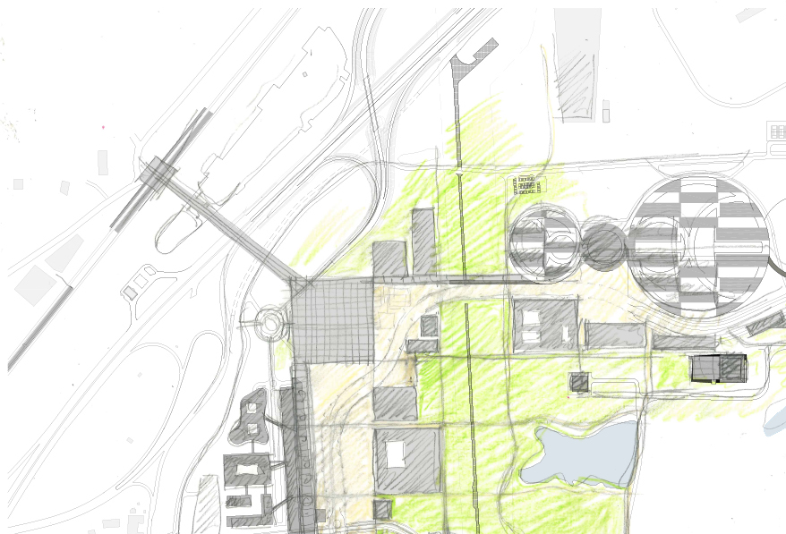
Transportation hub
Object breakdown:
Concourse
Pedestrian zone
Crosswalk above the federal highway

Slide 13
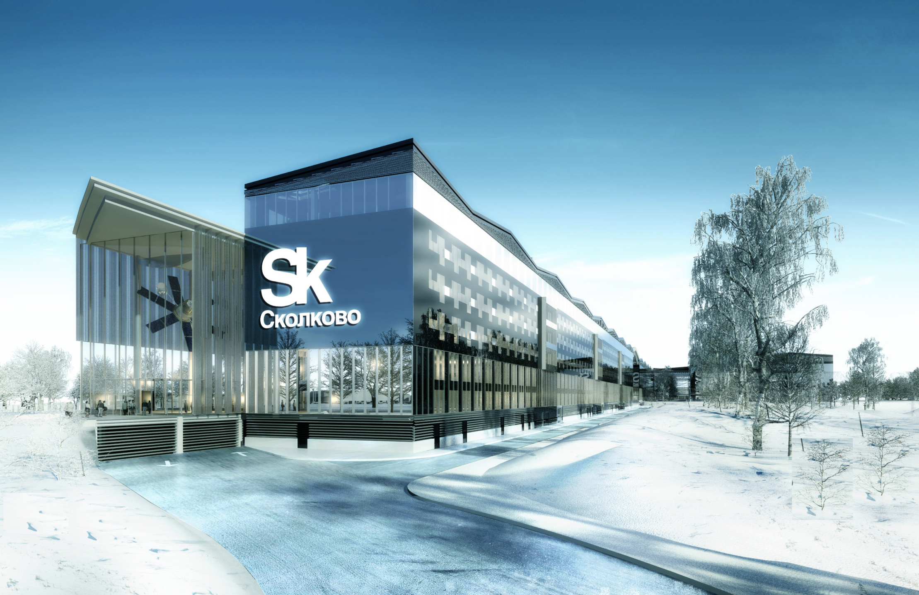
6. Office center Gallery
Stage P to be passed to expertise

Slide 14
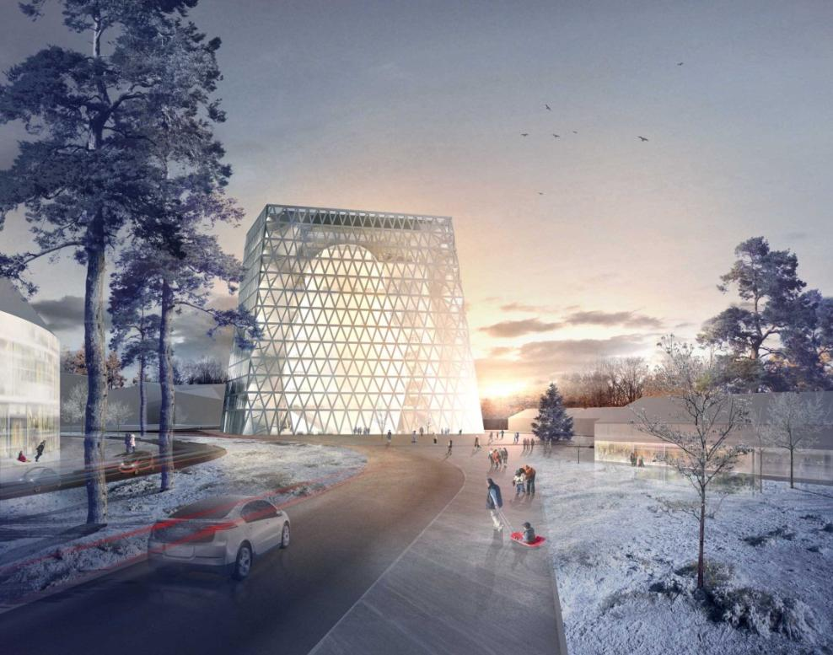
7. Business center Skolkovo
Stage P in expertise
Pre-construction works in process.

Slide 15
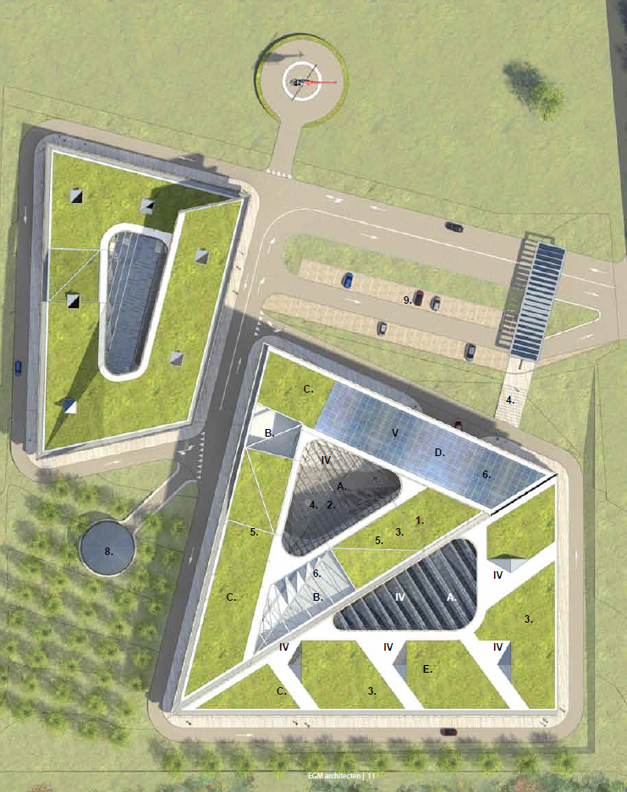
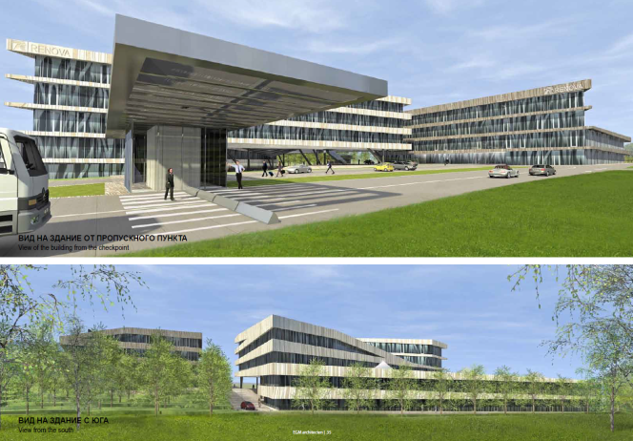
8. Renova Lab
Stage P in expertise
Pre-construction works in process.

Slide 16
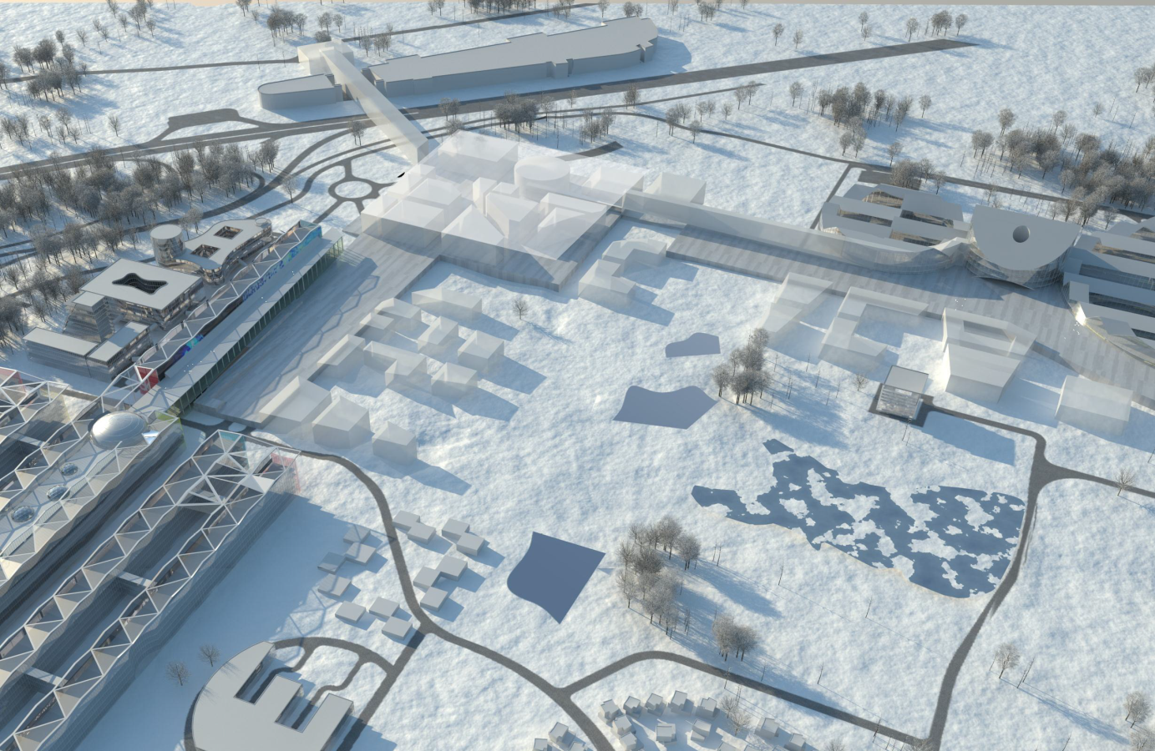
9. Central Zone
 | Construction area in quarters, sq. m
Objects | 1 (Guest) | 2 (Market) | (Creative) | 4 Student | 5 Teacher | TOTAL
Skolkovo Lounge | 10 000 |  |  |  |  | 10 000
Museum (exhibition center) |  |  | 5 000 |  |  | 5 000
Cultural (Nedia) Center |  | 6 000 |  |  |  | 6 000
Design Center |  |  | 5 000 |  |  | 5 000
Skoltech dormitories (with services) |  |  |  | 20 000 |  | 20 000
Servicing areas |  |  | 15 000 |  |  | 15 000
Market |  | 2 000 |  |  |  | 2 000
Infotainment |  |  | 10 000 |  |  | 10 000
Hotels | 30 000 |  |  |  |  | 30 000
Apartments |  |  | 20 000 |  | 9 000 | 29 000
Retail, Restaurants | 17 000 | 3 000 |  |  | 1 000 | 21 000
City Hall |  | 5 000 |  |  |  | 5 000
Sport |  |  | 20 000 |  |  | 20 000
Edutainment (Skolkovo Club) |  |  | 5 000 |  |  | 5 000
Parking | 60 000 |  |  |  |  | 60 000
TOTAL | 117 000 | 16 000 | 80 000 | 20 000 | 10 000 | 243 000
Funded by:
Skolkovo Foundation |  | 11 000 |  | 20 000 | 10 000 | 41 000
Investors | 117 000 | 5 000 | 80 000 |  |  | 202 000
1
2
5
3
4
The conception of the Central Zone is approved by the GovernmentКонцепция Центральной зоны согласована на уровне Правительства.
Sketch and design code of the Central Zone are prepared

